Slide 1
Components

Slide 2
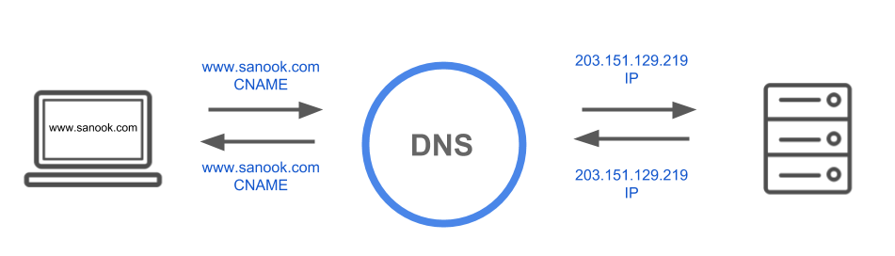
DNS: Domain Name System
It is a phone book of the internet from where humans access the IP address of their domain names.
DNS converts the domains to its IP address, so that it can be used for accessing the server.

Slide 3
How DNS converts www.google.com –> 172.217.160.164

Slide 4
DNS Server
A DNS server consists:
A Resolver
A Root Server
A TLD NameServer
A Authoritative namespace

Slide 5
Resolver
The resolver can be thought of as a librarian who is asked to go find a particular book somewhere in a library. The DNS resolver is a server designed to receive queries from client machines through applications such as web browsers. Typically the recursor is then responsible for making additional requests in order to satisfy the client’s DNS query.
In your case, when you browse something on internet browser, your ISP (Internet Service Provider) acts as a resolver.

Slide 6
Root Server
The root server is the first step in translating (resolving) human readable host names (www.example.com) into IP addresses (192.168.1.1). It can be thought of like an index in a library that points to different racks of books - typically it serves as a reference to other more specific locations.
Root Server
www.example.com
Sends the dns query to .com TLD nameserver

Slide 7
TLD Nameserver
The top level domain server (TLD) can be thought of as a specific rack of books in a library. This nameserver is the next step in the search for a specific IP address, and it hosts the last portion of a hostname (In example.com, the TLD server is “com”).
.com TLD Nameserver
Location of namespace where www.example.com may be available
www.example.com

Slide 8
Authoritative Nameserver
This final nameserver can be thought of as a dictionary on a rack of books, in which a specific name can be translated into its definition. The authoritative nameserver is the last stop in the nameserver query. If the authoritative name server has access to the requested record, it will return the IP address for the requested hostname back to the DNS Resolver (the librarian) that made the initial request.
Namespace
www.example.com
192.168.1.1

Slide 9
Steps in a DNS lookup
A user types ‘example.com’ into a web browser and the query travels into the Internet and is received by a DNS resolver.
The resolver then queries a DNS root nameserver (.).
The root server then responds to the resolver with the address of a Top Level Domain (TLD) DNS server (such as .com or .net), which stores the information for its domains. When searching for example.com, our request is pointed toward the .com TLD.
The resolver then makes a request to the .com TLD.
The TLD server then responds with the IP address of the domain’s nameserver, example.com.
Lastly, the recursive resolver sends a query to the domain’s nameserver.
The IP address for example.com is then returned to the resolver from the nameserver.
The DNS resolver then responds to the web browser with the IP address of the domain requested initially.
Once the 8 steps of the DNS lookup have returned the IP address for example.com, the browser is able to make the request for the web page:
The browser makes a HTTP request to the IP address.
The server at that IP returns the webpage to be rendered in the browser.

Slide 10
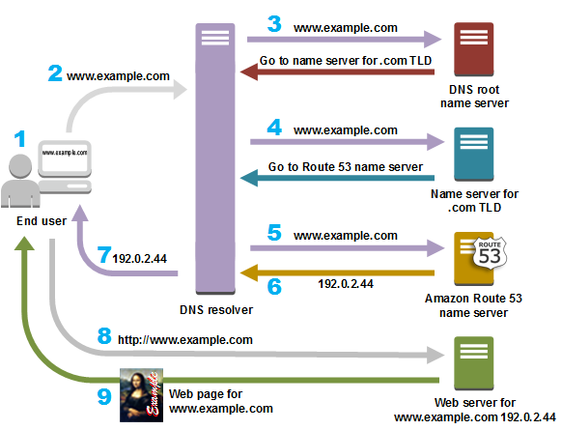
DNS Lookup

Slide 11
Content Delivery Network (CDN)

Slide 12
Content Delivery Network (CDN)
A content delivery network (CDN) is a globally distributed network of proxy servers, serving content from locations closer to the user. Generally, static files such as HTML/CSS/JS, photos, and videos are served from CDN, although some CDNs such as Amazon's CloudFront support dynamic content. The site's DNS resolution will tell clients which server to contact.

Slide 13
What are the benefits of using CDN?

Slide 14
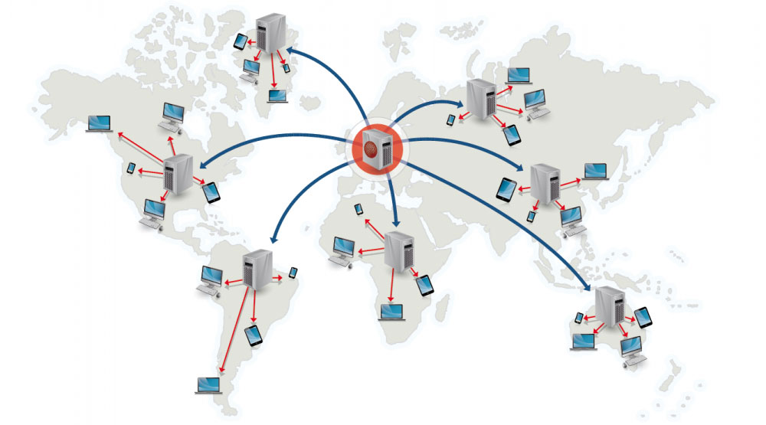
Benefits of including CDN in system design.
Serving content from CDNs can significantly improve performance in two ways:
Users receive content from data centers close to them
Your servers do not have to serve requests that the CDN fulfills

Slide 15
Types of CDN
There are two primary types of CDN
Push CDNs
Pull CDNs

Slide 16
Before moving forward Try to understand the need of pull and push CDNs?

Slide 17
Did you get the answer?

Slide 18
Let me tell you the need,
Assume, you’re the follower of Lionel Messi on Instagram. He uploads his picture after winning a match against of Portugal in Barcelona. So, Messi used Argentina CDN server for uploading his image. Now, You are in India and most probably using Indian Instagram server for fetching feeds on Instagram. So, How can you see Messi’s post in your feed?
From above situation, you get an idea that, there should an communication between different CDNs located globally. And this communication has types name pull and push.

Slide 19
Push CDN
Push CDNs receive new content whenever changes occur on your server. You take full responsibility for providing content, uploading directly to the CDN and rewriting URLs to point to the CDN.
You can configure when content expires and when it is updated. Content is uploaded only when it is new or changed, minimizing traffic, but maximizing storage.
Sites with a small amount of traffic or sites with content that isn't often updated work well with push CDNs. Content is placed on the CDNs once, instead of being re-pulled at regular intervals.

Slide 20
Pull CDN
Pull CDNs grab new content from your server when the first user requests the content. You leave the content on your server and rewrite URLs to point to the CDN. This results in a slower request until the content is cached on the CDN.
A time-to-live (TTL) determines how long content is cached. Pull CDNs minimize storage space on the CDN, but can create redundant traffic if files expire and are pulled before they have actually changed.
Sites with heavy traffic work well with pull CDNs, as traffic is spread out more evenly with only recently-requested content remaining on the CDN.

Slide 21
Disadvantages of CDNs
CDN costs could be significant depending on traffic, although this should be weighed with additional costs you would incur not using a CDN.
Content might be stale if it is updated before the TTL expires it.
CDNs require changing URLs for static content to point to the CDN.

Slide 22
Now, we already learnt about Horizontal Scaling in which we increase number of servers for high availability. So, How we can use our resources(servers) efficiently in heavy surge in traffic?

Slide 23
Load Balancers

Slide 24
Load Balancer
A Load balancer acts as a traffic cop sitting in front of your servers and routing the requests in order to maximizes speed and resource utilization and ensure that no one server is overloaded.
Just Like traffic cop redirects traffic to another route if any road is in construction, similarly When a server goes down, then it redirects traffic among all the remaining servers and in case a server is added then it redirects the traffic to that new server.

Slide 25
Benefits of Load Balancer
Load balancers are effective at:
Preventing requests from going to unhealthy servers
Preventing overloading resources
Helping to eliminate a single point of failure
Additional benefits include:
SSL termination - Decrypt incoming requests and encrypt server responses so backend servers do not have to perform these potentially expensive operations
Removes the need to install X.509 certificates on each server
Session persistence - Issue cookies and route a specific client's requests to same instance if the web apps do not keep track of sessions

Slide 26
On what basis Load Balancer route traffic?

Slide 27
Load balancers can route traffic based on various metrics, including:
Random
Least loaded
Session/cookies
Round robin or weighted round robin
Layer 4
Layer 7

Slide 28
Random
Description: In random load balancing, requests are distributed randomly to the available servers in the pool. There is no specific algorithm or criteria for routing requests, which means that any server can receive any request at any time.
Use Case: Random load balancing can be useful when you want a simple and low-overhead method for distributing traffic. However, it does not consider the server's load or performance, making it less suitable for applications where even load distribution or performance optimization is critical.
Public informational websites with no user-specific data uses random load balancing.

Slide 29
Least Loaded
Description: The least loaded algorithm directs incoming requests to the server with the fewest active connections or the lowest load. This ensures that requests are sent to the server that is currently the least busy.
Use Case: Least loaded balancing is suitable for applications where you want to evenly distribute traffic and ensure that servers are not overloaded. It's effective for maintaining good server performance and preventing overutilization.
It's commonly used for web applications, e-commerce sites, and services where maintaining server health and preventing overloading is critical

Slide 30
Session/cookies
Description: Session or cookie-based load balancing, also known as sticky sessions, involves directing a client to the same server for the duration of their session. A load balancer uses session cookies or other session identifiers to route subsequent requests from the same client to the server where their session data is stored.
Use Case: Sticky sessions are essential for applications that require session persistence, such as e-commerce sites or applications with user logins. They ensure that a user's session data is consistently available on the same server.
It’s commonly used by e-commerce platforms, web applications with user logins, and online collaboration tools.

Slide 31
Round robin or weighted round robin
Description: In round-robin load balancing, incoming requests are distributed to the available servers in a circular order, one at a time. Weighted round robin is a variation that assigns different weights to servers, so servers with higher weights receive more requests than those with lower weights.
Use Case: Round robin is simple and ensures that each server gets an equal share of the traffic, making it a good choice for basic load balancing. Weighted round robin is used when some servers have more capacity or resources than others and should handle a larger portion of the load.
It’s commonly used by content delivery networks (CDNs), web servers, and DNS servers.

Slide 32
Thank You

